Slide 1

2019 October Desert Data Science User Group Real-world Document Classification with Transfer Learning
Pradeep Thiyyagura
Data Scientist
Neudesic

Slide 2
"Neural networks, a beautiful biologically-inspired programming paradigm which enables a computer to learn from observational data."
- Michael Nielsen

Slide 3
Goals
Provide an overview of Machine Learning and Natural Language Processing
Get introduced to Transfer Learning and fast.ai library
Share some tips from implementing text classification techniques in real world
Build an algorithm to classify 20K news articles into 20 categories

Slide 4
Why?
There is lot of unstructured text data in the world
There is tremendous value to be extracted
We can achieve SOTA results with fewer example to train

Slide 5
Schedule
Theory
Machine Learning
Practice
Fastai.text
Multi-Label Classification
Real-World Example
Natural Language Processing
Transfer Learning

Slide 6
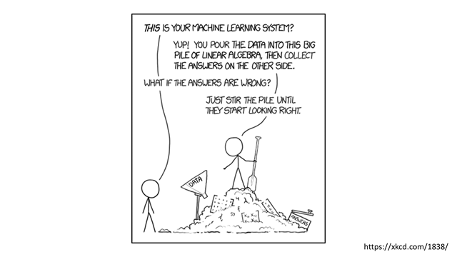

Slide 7
How do Machines Learn ?
Input
Target
Model
Loss Function
Prediction
Update Weights

Slide 8
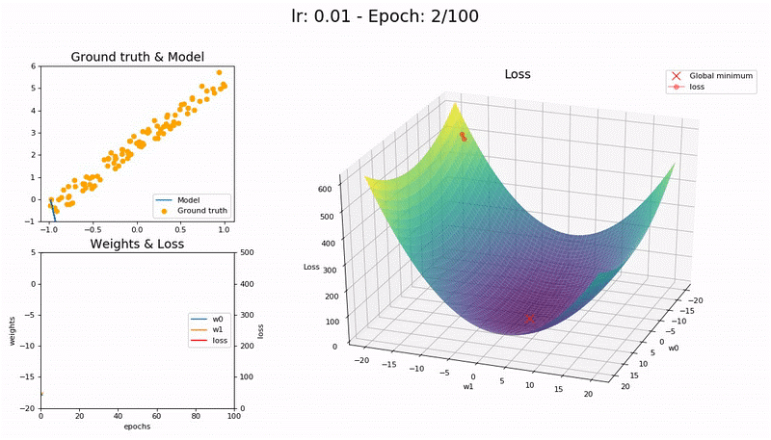

Learning Rate - Low
Source
Notes:
https://forums.fast.ai/t/share-your-work-here/27676/300

Slide 9
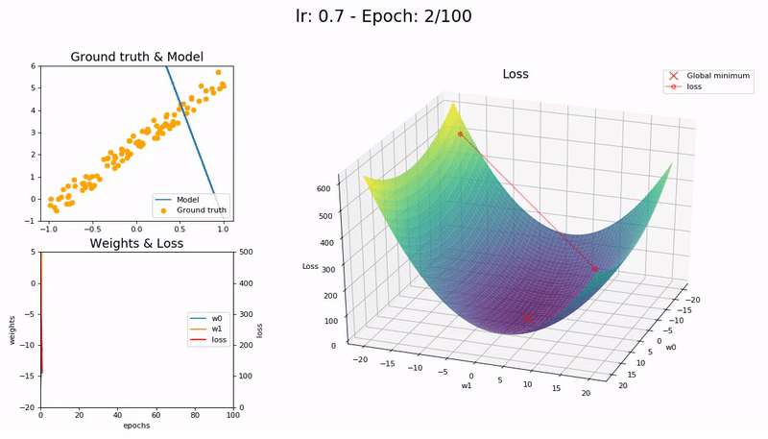
Learning Rate - Just right
Source
Notes:
https://forums.fast.ai/t/share-your-work-here/27676/300

Slide 10

Learning Rate - High
Source
Notes:
https://forums.fast.ai/t/share-your-work-here/27676/300

Slide 11
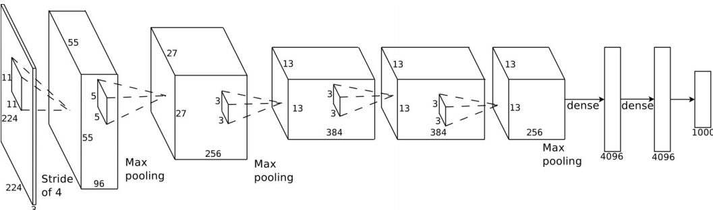
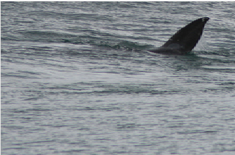
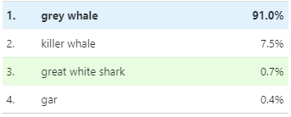
Computer Vision: ImageNet
Source
Notes:
https://distill.pub/2019/activation-atlas/
http://image-net.org/challenges/LSVRC/2012/supervision.pdf

Slide 12
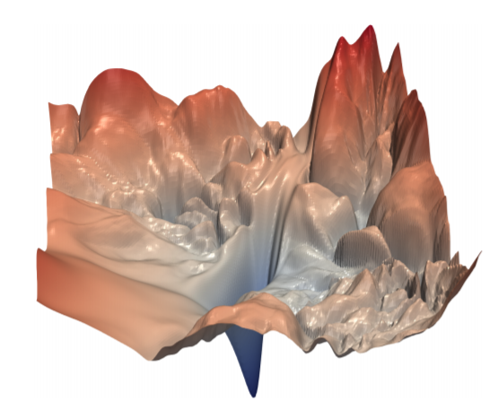
Loss Landscape
Source
Notes:
https://papers.nips.cc/paper/7875-visualizing-the-loss-landscape-of-neural-nets.pdf

Slide 13
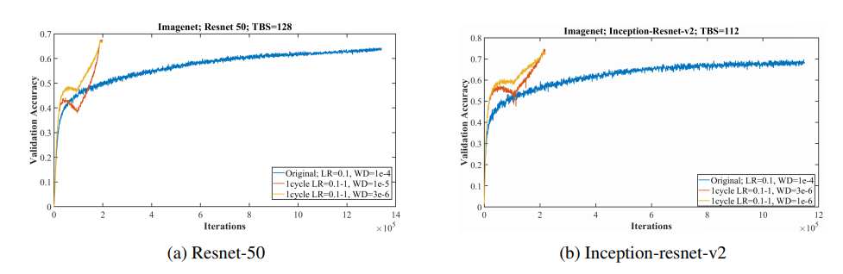
1Cycle Policy
Neural networks can be trained an order of magnitude faster than with standard training methods.
Leslie N. Smith 2018
Notes:
Training resnet and inception architectures on the imagenet dataset with the standard learning rate policy (blue curve) versus a 1cycle policy that displays super-convergence. Illustrates that deep neural networks can be trained much faster (20 versus 100 epochs) than by using the standard training methods.
https://arxiv.org/pdf/1803.09820.pdf

Slide 14
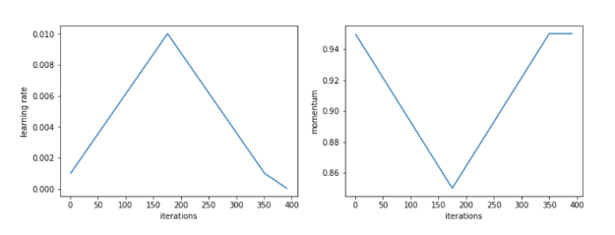
1 Cycle Policy
Learning rate:
Source
Notes:
https://sgugger.github.io/the-1cycle-policy.html

Slide 15
1 Cycle Policy
Learning rate:
Source
Notes:
https://sgugger.github.io/the-1cycle-policy.html

Slide 16
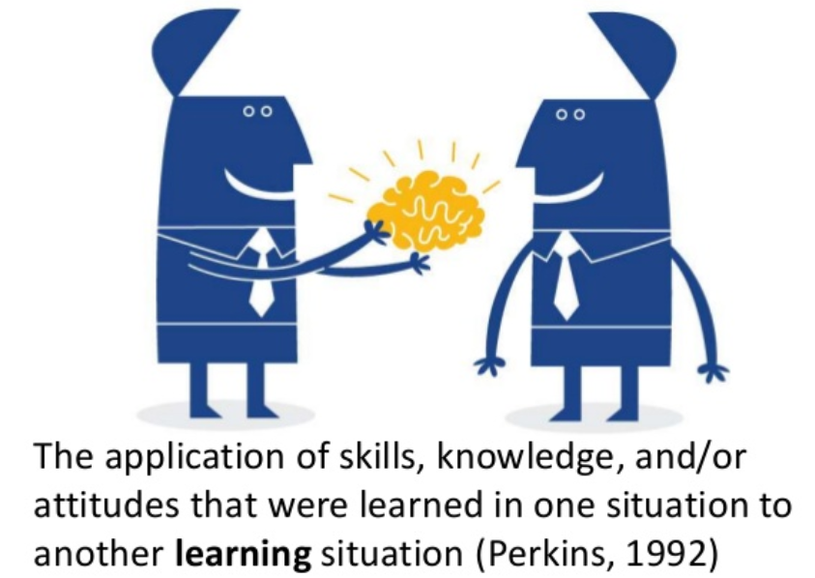
Transfer Learning

Slide 17
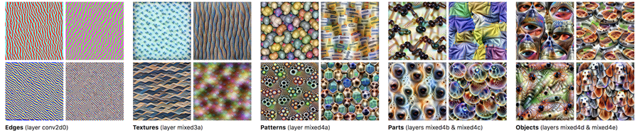
Computer Vision: ImageNet
Source
Notes:
https://distill.pub/2019/activation-atlas/
http://image-net.org/challenges/LSVRC/2012/supervision.pdf

Slide 18
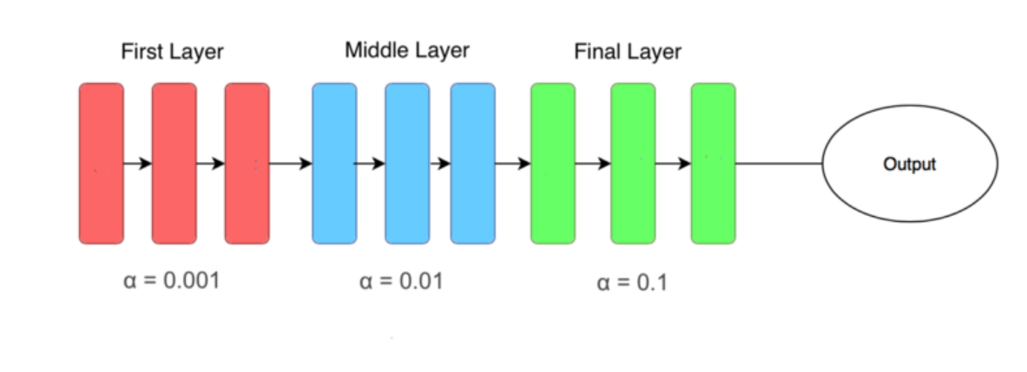
Discriminative Learning Rate
Source
Notes:
https://blog.floydhub.com/ten-techniques-from-fast-ai/

Slide 19
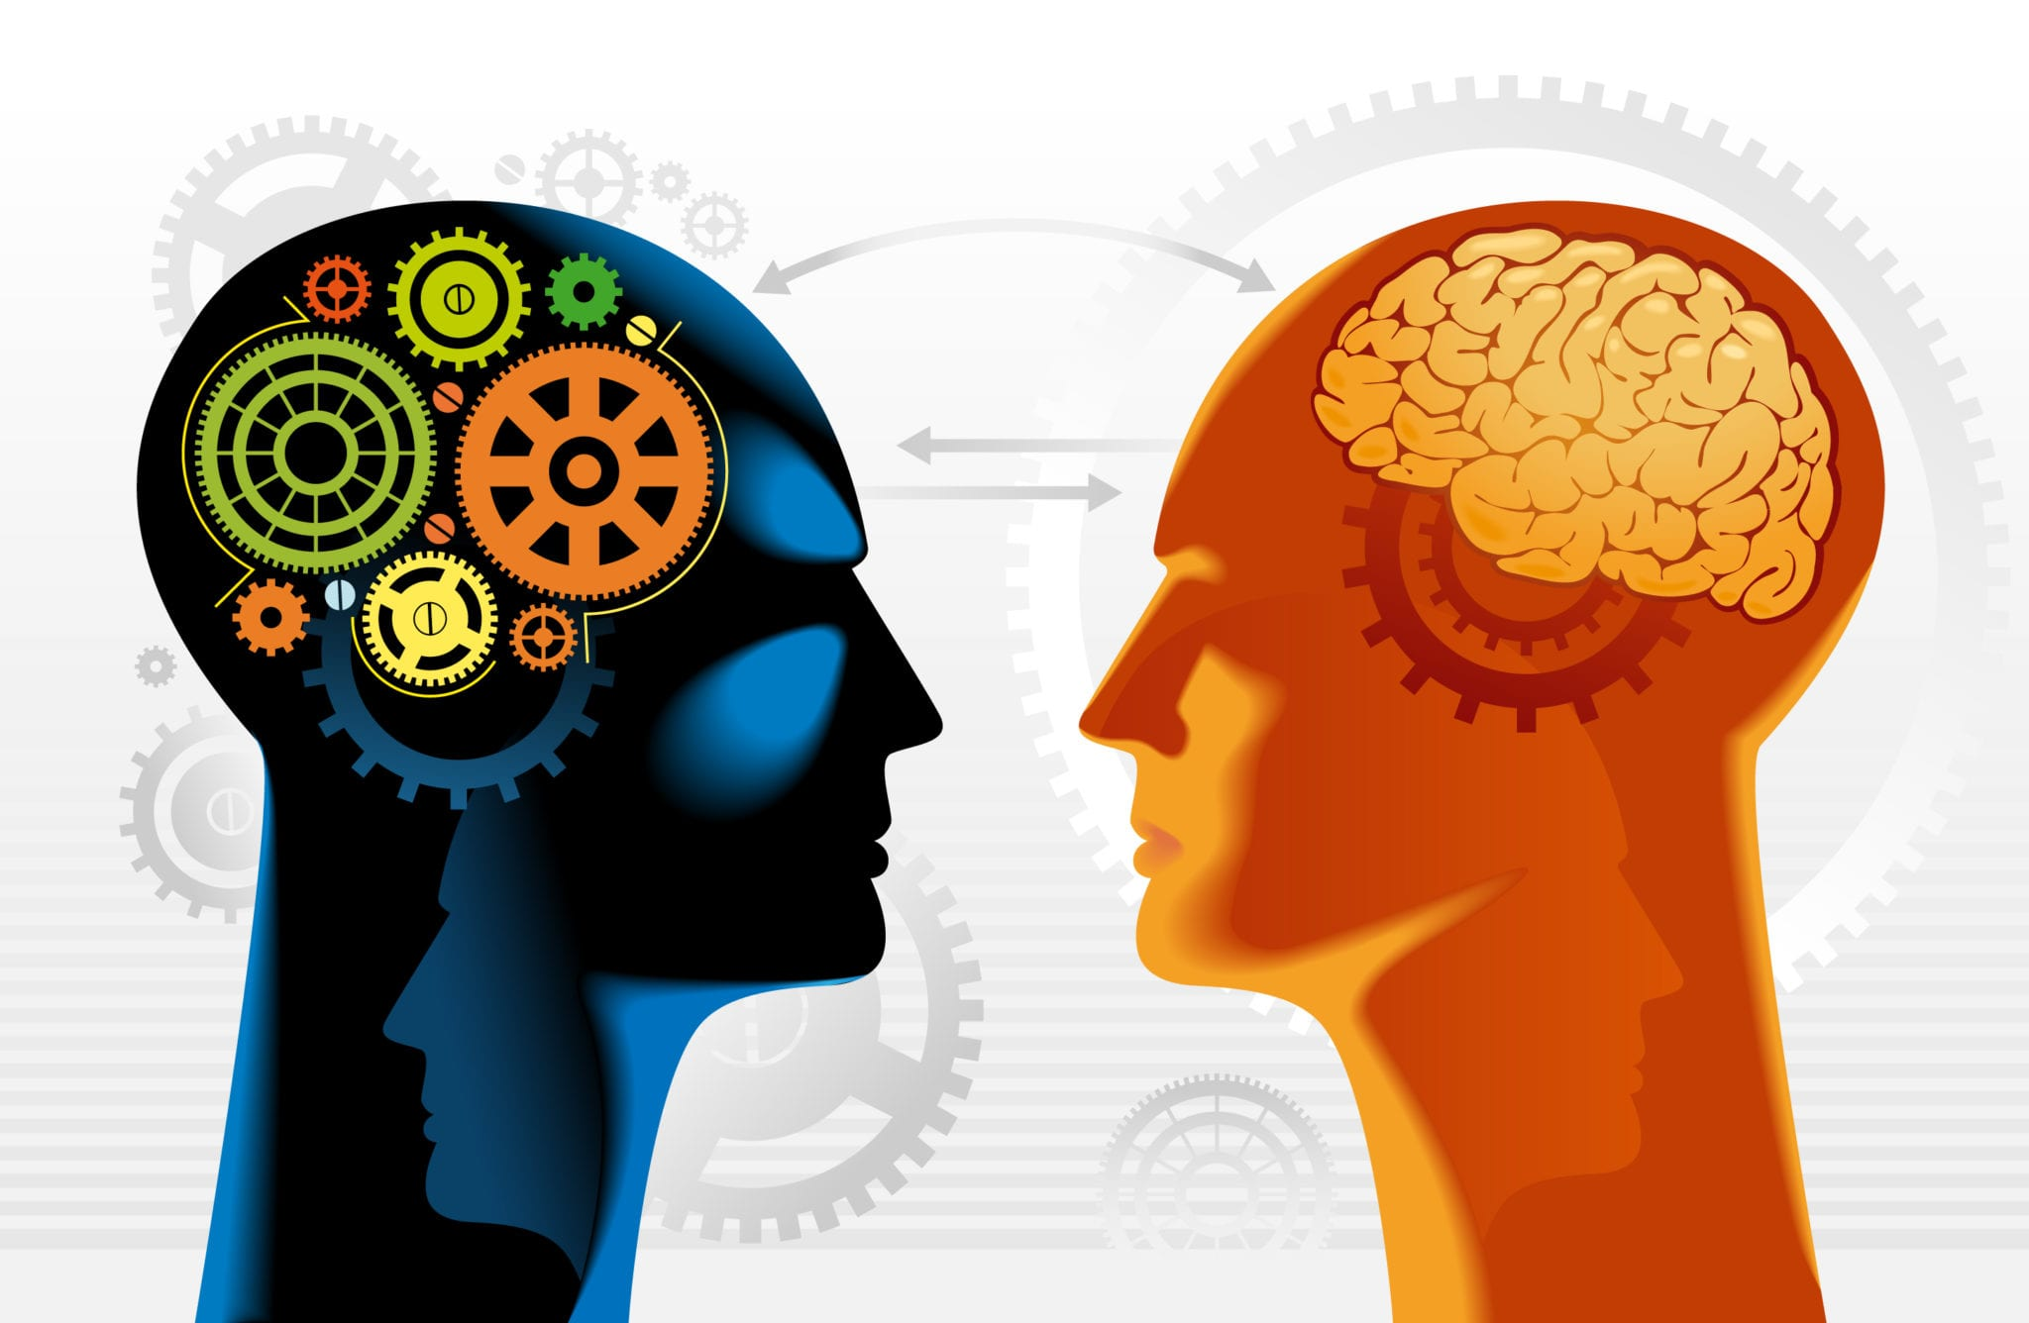
Natural Language Processing
NLP is a branch of artificial intelligence that deals with the interaction between computers and humans using the natural language.
Source
Notes:
https://www.analyticsinhr.com/blog/natural-language-processing-revolutionize-human-resources/
The ultimate objective of NLP is to read, decipher, understand, and make sense of the human languages in a manner that is valuable.

Slide 20
Language Model
Language is application independent
Language model aims to predict the next word given its previous word
Wikitext
103
Language Model
Client
Language Model
Client
Classifier
Howard and Ruder 2018

Slide 21
Sample Task
Classify ~20 thousand documents into 20 record series

Slide 22
Fast.ai - Making neural nets uncool again
Python based toolkit
Built on top of Pytorch
Tools for classification, regression, time-series, collaborative filtering, data preparation, interpretation
Most modern transfer learning techniques are implemented
Easy to use
fastai

Slide 23
Setting up fast.ai Environment
Install Anaconda
https://www.anaconda.com/distribution/
Install Git
https://gitforwindows.org/
Create Fastai virtual environment
Update conda: $conda update conda
Create new conda env: $conda create –n fastai_v1
Activate environment: $activate fastai_v1
Install fastai: $conda install fastai pytorch=1.0.0 -c fastai -c pytorch -c conda-forge
Install pykernel: $conda install nb_conda_kernels
Setup pykernel displayname: $python -m ipykernel install --user --name fastai_v1 --display-name "fastai v1"
Source
Notes:
https://medium.com/@pierre_guillou/how-to-install-fastai-v1-on-windows-10-ca1bc370dce4

Slide 24
Demo

Slide 25
Model Interpretability
Increased Transparency
Better Understanding
Debugging

Slide 26
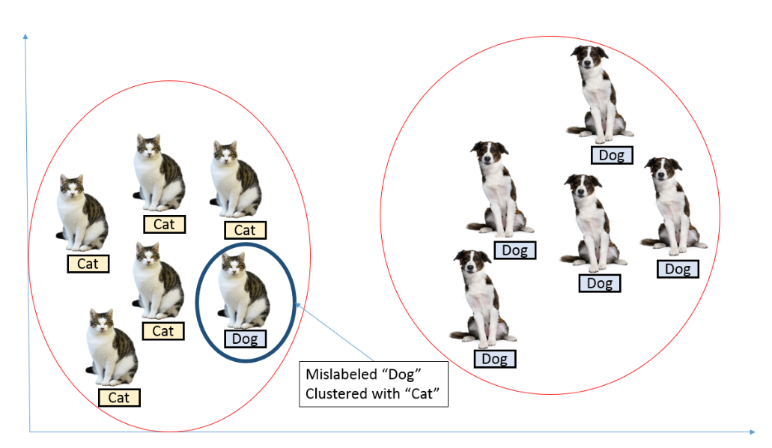
Label Smoothing
Label smoothing will help the model to train around mislabeled data and consequently improve its robustness and performance.
Training labels will be 1-β for cat and β for not cat
Notes:
https://towardsdatascience.com/label-smoothing-making-model-robust-to-incorrect-labels-2fae037ffbd0

Slide 27

Practical Tips
If you can’t solve a problem analytically, solve it iteratively
Use what the model already knows and correct its predictions
If the results are bad, is it your model or are your labels bad?
Good annotation teams are small. Collaborate with them regularly
Data is the new software. Iterate on your code and data
If things don’t work, don’t be afraid to scale down

Slide 28

Acknowledgments
Neudesic Team
Ying Li
Pranav Rao
Jared Wilber
Maxwell Curry

Slide 29
References and Resources
•Practical Deep Learning for Coders fastai
•But what is a Neural Network? 3blue1brown
•Visualizing a Neural Machine Translation Model Jay Alammar
•Neural Networks and Deep Learning Michael Nielsen
•Building new NLP solutions with spaCy and Prodigy Matthew Honnibal
•Software 2.0 Andrej Karpathy
•Pydata Conference Talks Pydata

Slide 30

Thank you!
Questions?

